Slide 1

Data Science For Business
January 2025
Module 4 – Regularization

Slide 2
Quiz time!

Slide 3
Quiz discussion!

Slide 4
Q1
What does increasing the degree of a polynomial model typically do to the model’s fit?
 | Improves the fit on both training and test data indefinitely
 | Reduces complexity and risk of overfitting
 | Increases complexity, potentially leading to overfitting
 | Has no significant impact on the fit

Slide 5
Q1
What does increasing the degree of a polynomial model typically do to the model’s fit?
 | Improves the fit on both training and test data indefinitely
 | Reduces complexity and risk of overfitting
 | Increases complexity, potentially leading to overfitting
 | Has no significant impact on the fit

Slide 6
Q2
Why is cross-validation a better approach than a simple train-test split?
 | It uses more training data for model fitting
 | It reduces the variance in evaluation metrics for test sets It tests every instance at least once
 | All of the above

Slide 7
Q2
Why is cross-validation a better approach than a simple train-test split?
 | It uses more training data for model fitting
 | It reduces the variance in evaluation metrics for test sets It tests every instance at least once
 | All of the above

Slide 8
Q3
Which of the following indicates overfitting in a model?
 |  | Low accuracy on training data but high on test data
 |  | High accuracy on training data but low on test data
 |  | High accuracy on both training and test datasets
 |  | Equal accuracy on training and test datasets

Slide 9
Q3
Which of the following indicates overfitting in a model?
 |  | Low accuracy on training data but high on test data
 |  | High accuracy on training data but low on test data
 |  | High accuracy on both training and test datasets
 |  | Equal accuracy on training and test datasets

Slide 10
Q4
We've now looked at two types of supervised learning problems. What are they and what is one model for each type of problem?

Slide 11
Q4
We've now looked at two types of supervised learning problems. What are they and what is one model for each type of problem?
Supervised Learning
Classification / Probability Estimation
Decision tree
Linear/ polynomial logistic regression
Regression
Linear/polynomial regression
Regression tree

Slide 12
Agenda
Week 1
Module 1 (Thursday): Intro to data science + Python for DS
Module 2 (Friday): Intro to supervised learning
Week 2
Module 3 (Monday): Fitting models, generalization
Module 4 (Tuesday): Regularization
Module 5 (Wednesday): Evaluation (ROC, cost visualization)
Module 6 (Thursday): Modeling text data
Week 3
Module 7 (Monday): Neural networks, GenAI
Module 8 (Tuesday): Guest lecture(s)
Module 9 (Wednesday): Causal inference, AB testing, wrap up
Final Exam (Thursday)

Slide 13
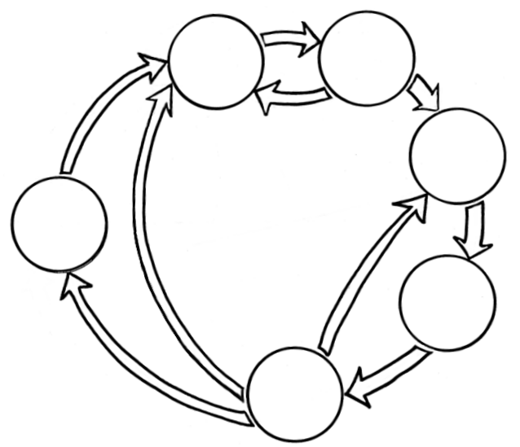
Where we are
Business Understanding
Data Understanding
Data Preparation
Data Science
Process
Deployment
Modeling
Evaluation

Slide 14
Where we are
Business Understanding
Data Understanding
Last class
Data Preparation
Data Science
Process
Deployment
Modeling
Evaluation

Slide 15

Building Your Toolbox
Business Understanding
Data Understanding
Last class
Types of Tasks and Models
Data Preparation
Supervised Learning
Data Science
Process
Classification / Probability Estimation
Deployment
Decision tree
Linear/polynomial logistic regression
Modeling
Regression
Linear/polynomial regression
Regression tree
Evaluation

Slide 16
Recap
Last class
Linear/polynomial regression

Slide 17
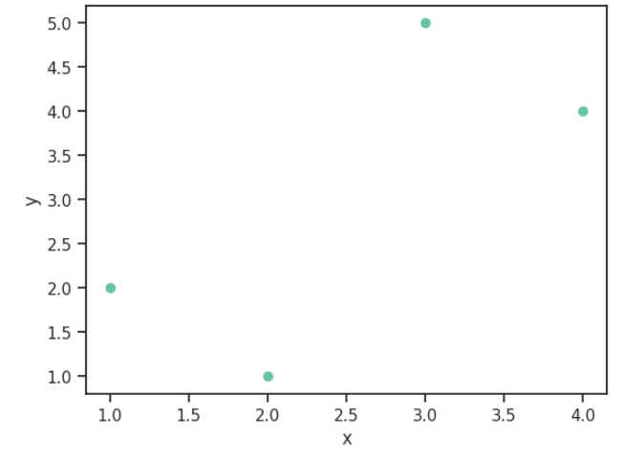
Recap
Last class
Linear/polynomial regression
We talked briefly about how we use a loss function to pick the line of best fit

Slide 18
Recap
Last class
Linear/polynomial regression
We talked briefly about how we use a loss function to pick the line of best fit
This is very similar to the objective function
(Often this is the case:
objective function = - loss function)

Slide 19
Recap
Last class
Linear/polynomial regression
In regression the loss function is typically: Mean Squared Error
What does this mean?

Slide 20
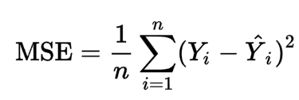
Recap
Last class
Linear/polynomial regression
In regression the loss function is typically: Mean Squared Error (MSE)
MSE = average squared error between our model’s prediction for the target and the true target value

Slide 21
Recap
Last class
Linear/polynomial regression
If we find the line parameters that minimize MSE, we get a “good fitting” line

Slide 22
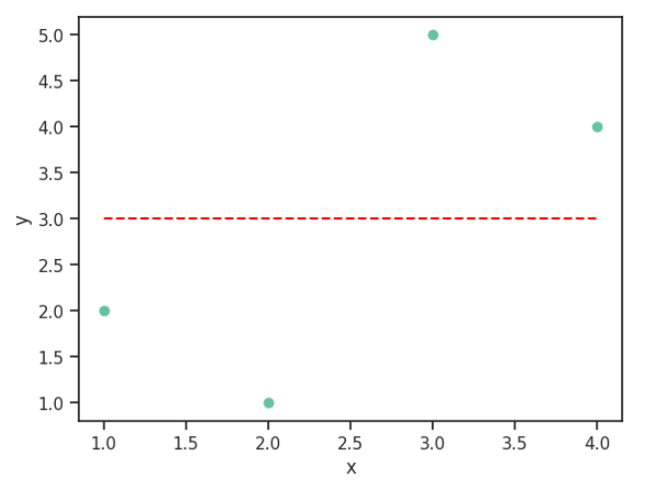
Recap
Last class
Linear/polynomial regression
y_hat = mx + b = w₁x + w₀

Slide 23
Recap
Last class
Linear/polynomial regression
y_hat = mx + b = w₁x + w₀
w₁=0
w₀=3

Slide 24
Recap
Last class
Linear/polynomial regression
y_hat = mx + b = w₁x + w₀
w₁=0
w₀=3
y_hat = [3, 3, 3, 3]
MSE = 2.5

Slide 25
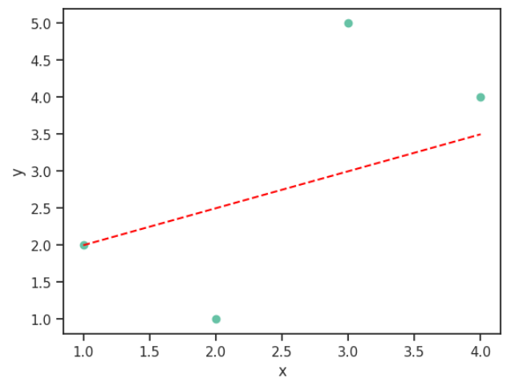
Recap
Last class
Linear/polynomial regression
y_hat = mx + b = w₁x + w₀
w₁=.5
w₀=1.5
y_hat = [2, 2.5, 3, 3.5]
MSE = 1.625

Slide 26
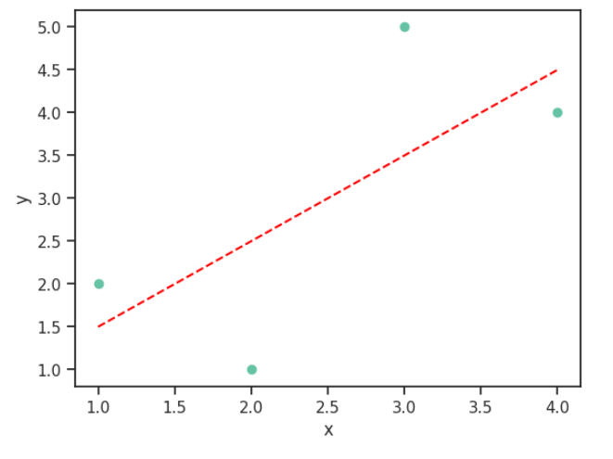
Recap
Last class
Linear/polynomial regression
y_hat = mx + b = w₁x + w₀
w₁=1
w₀=.5
y_hat = [1.5, 2.5, 3.5, 4.5]
MSE = 1.25

Slide 27
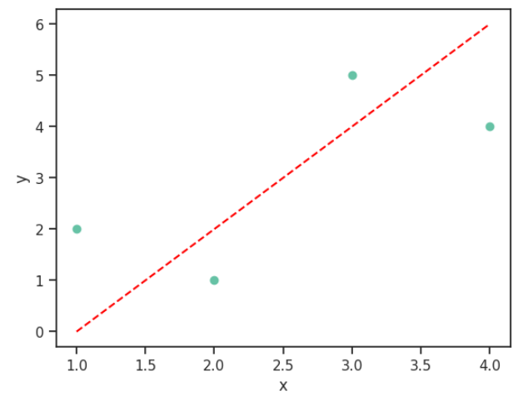
Recap
Last class
Linear/polynomial regression
y_hat = mx + b = w₁x + w₀
w₁=2
w₀= -2
y_hat = [0, 2, 4, 6]
MSE = 2.5

Slide 28
Recap
Last class
Linear/polynomial regression
y_hat = mx + b = w₁x + w₀
w₁=.5
w₀=1.5
This one’s the best!
y_hat = [1.5, 2.5, 3.5, 4.5]
MSE = 1.25

Slide 29
Recap
Last class
Linear/polynomial regression
If we have more than 1 feature (x), our line equation looks like:
y_hat = w₁₀x₁₀ + … + w₂x₂ +w₁x₁ + w₀

Slide 30
Building Your Toolbox
Last class
Question!
We actually do polynomial regression with a linear regression. How do we do this? (Hint: it involves manipulating the features themselves)

Slide 31
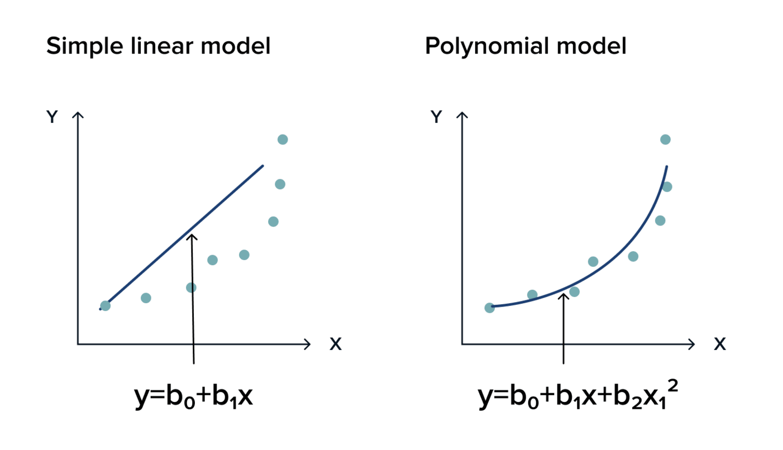
Building Your Toolbox
Last class
Question!
We actually do polynomial regression with a linear regression. How do we do this? (Hint: it involves manipulating the features themselves)
We construct polynomial/non-linear features!
y_hat = w₂x² + w₁x + w₀
_{or} y_hat = w₃x³ ₊ w₂x² + w₁x + w₀
_{or} y_hat = w₄x₂² ₊ w₃x₂ + w₂x₁² + w₁x₁ + w₀

Slide 32

Building Your Toolbox
Business Understanding
Data Understanding
Last class
Evaluation Techniques/Considerations
Data Preparation
Data Science
Process
Overfitting (the training data) → worse generalization (on unseen data)
K-fold cross-validation is a way to evaluate generalization
Deployment
Modeling
Evaluation

Slide 33



Building Your Toolbox
Business Understanding
Data Understanding
Today
Data Preparation
Data Science
Process
Deployment
Modeling
Evaluation

Slide 34



Building Your Toolbox
Business Understanding
Data Understanding
Today
Show more ways to prevent overfitting = ensure generalization
Data Preparation
Data Science
Process
Deployment
Modeling
Evaluation

Slide 35
Building Your Toolbox
Today
How to avoid overfitting? → Regularization
L1, L2
Data preparation to perform regularization well
Normalization
Standardization
How to avoid overfitting? → Hyper-parameter tuning
How to assess degree of hyper-parameter tuning? → Cross validation on training set
How to assess amount of data on generalization performance? → Learning curves

Slide 36
Notebook time!

